Slide 1


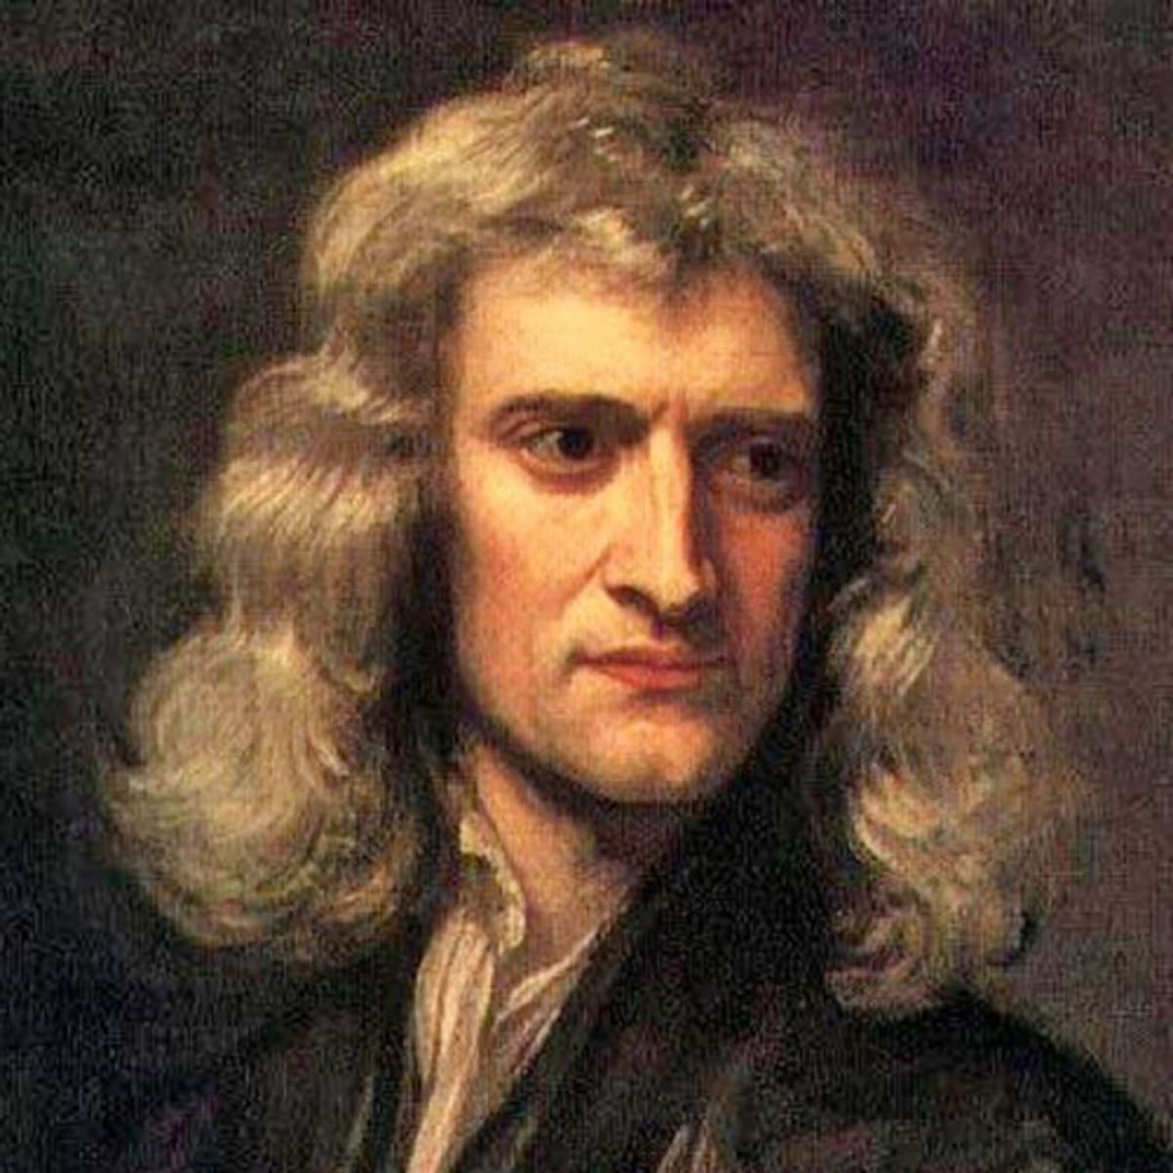
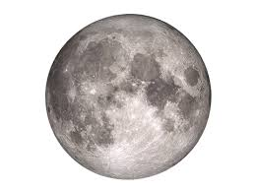
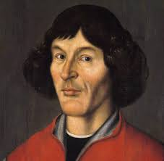
解密神奇的宇宙 Unlocking the secrets of the Universe
Session 3.1: from atoms to strings
What stuff is made of
Today’s VIP guest list
The Universe is a very big place. However, everything in the Universe is made up of very small things: atoms, which in turn are made up of hadrons, which in turn are made up of quarks, which – perhaps – are made up of even smaller things.
This “particle zoo” is organized and standardized in the Standard Model, which is the key paradigm in modern physics.
Scientists have constructed powerful machines to smash particles together at very high speeds and see what happens. Usually, this way we can see what makes up particles.
The Standard Model explains almost everything in our Universe. Unfortunately, it fails to account for one very important force we all experience every day: namely the gravity.
Isaac Newton
Session objectives
Learn about the two key Elementary Particle types: fermions and bosons
Understand how hadron colliders work
Ponder the shortcomings of the Standard Model theory
Key terms
Standard Model
标准模型
Elementary Particles
基本粒子
hadron collider / particle accelerator
粒子加速器
Elementary Interactions
基本互动
fermions
费米子
bosons
玻色子

Slide 2

解密神奇的宇宙 Unlocking the Secrets of the Universe
Elementary particles
基本粒子
Particles that (as far as we know!) are the most basic building blocks of matter. In other words, elementary particles can’t be further broken down into smaller building blocks.
Bosons
玻色子
Particles that mediate interactions between particles. You can imagine that it works like a “messenger” – it tells particle B that particle A ”is close!” and the two should interact.
Forces of nature
Also known as elementary interactions. They are the four different types of interactions that happen between elementary particles, according to the Standard Model of particle physics.
Electricity = magnetism?
One of the most important unification theories in history of physics was realization that magnetism and electricity can actually be described as two manifestations of a single force: electromagnetism
Electromagnetism was unified by James Clark Maxwell in 19th c., and together with Newton’s gravity it was thought to explain basically everything in the world. That is, until relativity and later quantum theory popped up in 20th c.
The four “forces of nature”
According to the Standard Model theory, all interactions between particles of matter can be summarized using 4 “forces” or “interactions:
Our old friend gravity
Electromagnetism
Strong interaction, which holds particles together
Weak interaction, which is responsible for radioactive decay
Why four…?
Why do we have 4 forces in the Standard Model theory?
Standard Model assumes that 2 particles “know about each other” and can interact via a messenger particle, also known as “boson”
Why do electrons repel?
Standard Model explains electron repulsion using bosons.
When 2 electrons are close to each other, one of them emits a photon, which changes the electron’s trajectory (direction of motion), due to conservation of momentum.
The other electron receives the photon, which also changes its trajectory, according to the same principle.
Imagine you and your friend are both standing on top of skateboards. You are holding a basketball and throw it to your friend.
What will happen to you and your friend?
JinJin STEM Academy

Slide 3
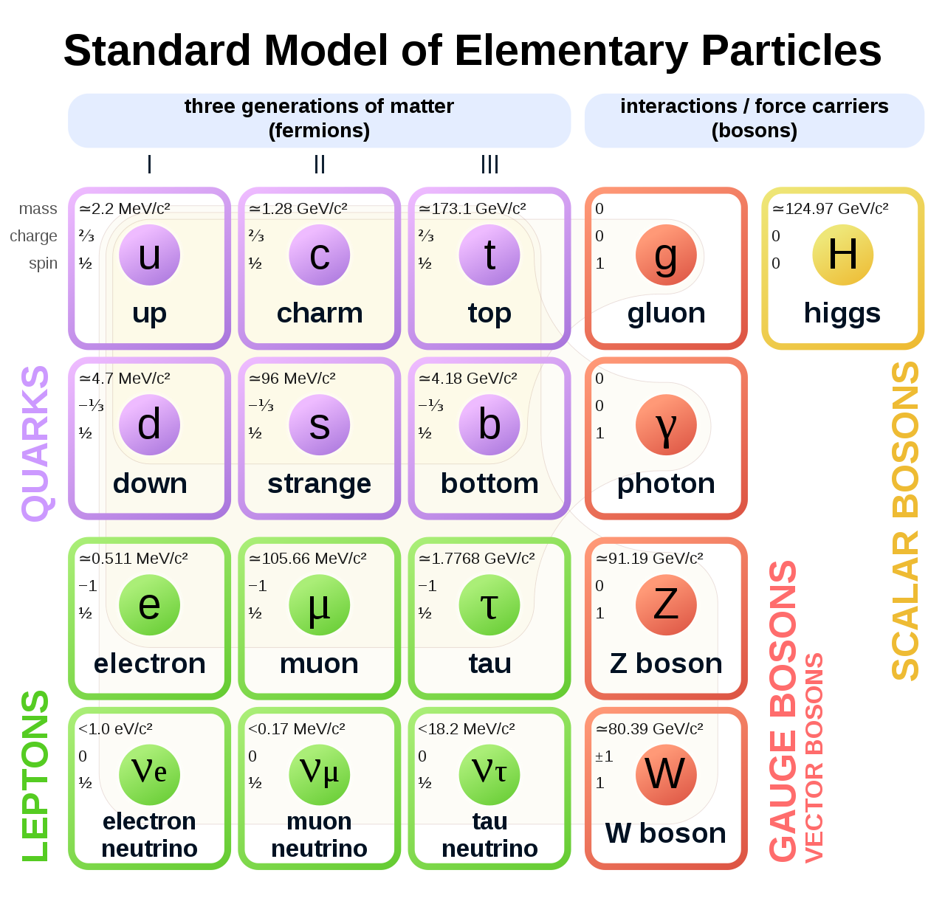
解密神奇的宇宙 Unlocking the Secrets of the Universe
The “particle zoo” of the Standard Model
When scientists first started conducting particle collision experiments to discover new particles, initially they could not make sense of what they were seeing: hundreds and hundreds of new particles popping out of the experiments! This seemed like a very complicated model that we should not trust due to Ockham's Razor principle.
After years of experiments, scientists managed to summarize all (known) particles into just 2 families:
Fermions, they make up stuff
Boson, the messenger particles
1
Elementary particles emerged from the “particle zoo” as building blocks of other particles.
How do we know that these particles are “truly elementary” and they have no smaller building blocks?
JinJin STEM Academy

Slide 4
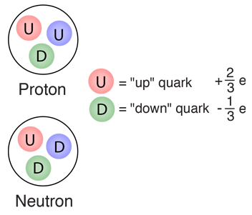
解密神奇的宇宙 Unlocking the Secrets of the Universe
Quarks make up hadrons – you already know hadrons!
1
http://hyperphysics.phy-astr.gsu.edu/hbase/Particles/quark.html
Leptons are really, really small
Electrons: we all know and love them. They are useful particles.
Neutrinos are almost massless, hardly ever interact with anything, and don’t really do anything.
However, observing neutrinos can tell us a lot about the events that created them, such as supernova explosions, black holes, etc.
All fermions also have anti-fermions (anti-particles)
Anti-particles are known as anti-matter
If anti-matter meets matter, they usually collide and annihilate (destroy) each other, emitting energy as photons.
JinJin STEM Academy

Slide 5
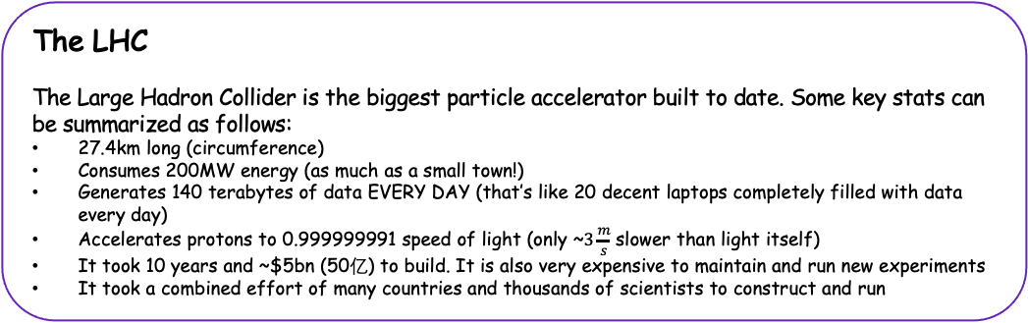
解密神奇的宇宙 Unlocking the Secrets of the Universe
Hadron colliders (particle accelerators)
In order to detect more and more particles, we often smash particles together and see what happens.
Machines used for smashing particles are called particle accelerators, or hadron colliders (because they smash hadrons together)
In some experiments we smash together leptons, so the machines used for the smashing should be called “lepton colliders”. Particle accelerator is a general name for any machine accelerating any kind of particle. If we smash together hadrons (usually protons), then the machine is indeed a “hadron collider”
How can we accelerate protons in a particle accelerator?
Linear Colliders
The structure of a linear collider is simple: it’s just a long tube in which particles are accelerated before hitting a specific target.
Linear Colliders are used not only in physics research, but also in hospitals for generating particle streams used in radiotherapy (cancer treatment)
Circular Colliders
Circular colliders accelerate the particles and at the same time bend their trajectory (path) so that the particles always remain on a fixed circular path.
The largest circular collider built to date is located in Switzerland
The LHC
The Large Hadron Collider is the biggest particle accelerator built to date. Some key stats can be summarized as follows:
27.4km long (circumference)
Consumes 200MW energy (as much as a small town!)
Generates 140 terabytes of data EVERY DAY (that’s like 20 decent laptops completely filled with data every day)
Accelerates protons to 0.999999991 speed of light (only ~$3\frac{m}{s}$ slower than light itself)
It took 10 years and ~$5bn (50亿) to build. It is also very expensive to maintain and run new experiments
It took a combined effort of many countries and thousands of scientists to construct and run
JinJin STEM Academy

Slide 6
解密神奇的宇宙 Unlocking the Secrets of the Universe
How are particles accelerated?
Why do we construct circular particle accelerators?
👉 Electric field accelerates particles
👉 Magnetic field keeps particles on a circular orbit
Are particle accelerators “useful”?
Why do humans spend so much money, time and effort on discovering and exploring the basic principles of the Universe?
Cancer treatment technologies, such as PET scans, are a product of Particle Physics
Touchscreens were first developed at CERN (home of the LHC)
The Internet (WWW) was created by particle physicists to communicate with their colleagues across the globe
Accelerators are used in certain industrial processes as well
JinJin STEM Academy

Slide 7
解密神奇的宇宙 Unlocking the Secrets of the Universe
Session Summary
Elementary Particles are the tiniest building blocks of matter (fermions) + the messenger particles that tell them how to interact with one another (bosons)
The model describing this system of particles is called the Standard Model of Particle Physics.
We can detect and study elementary particles by smashing them against one another in particle accelerators such as the Large Hadron Collider
Ponder before next class
Discovering new particles can tell us about what things are made of, and explain a lot about e.g. how the Universe was created. But do you think such investment is “worth the money” bearing in mind how expensive it is to construct the large particle accelerators?
The Standard Model explains almost everything about the universe’s basic mechanisms. Do you think it is close to being the “ultimate theory” or everything?
Is the Standard Model “simple”?
JinJin STEM Academy

